Slide 2

Movie Recommendation System

Slide 3
Movie Recommendation System
Student’s Name | Roll Number | Branch
Revanth Sai Bomma | 1/23/SET/BCS/417 | CSE AIML
Himani Sharma | 1/23/SET/BCS/425 | CSE AIML
Under the Guidance of
Ms. Shaveta Jain

Slide 4
CONTENTS
Introduction
Literature review
Proposed model
Proposed methodology
Results
Future scope
References

Slide 5
Introduction
The success of a movie often depends on multiple factors such as:
1. Audience sentiment
2. Number of votes
3. Critical reviews
In the age of digital platforms, movie ratings on websites like IMDB play a crucial role in:
1. Reflecting public opinion
2. Influencing viewers’ movie-watching decisions
This project focuses on analyzing and predicting IMDB movie ratings using a combination of:
1. Quantitative data → Number of Votes
2. Qualitative data → Sentiment from Movie Overview
The project utilizes TextBlob for extracting sentiment polarity (emotional tone) from movie overviews.
A Decision Tree Regressor is employed for predictive modeling due to its interpretability and ability to handle nonlinear relationships.
The system provides an efficient and explainable approach to understanding the key factors that drive higher IMDB ratings.

Slide 6
Literature review
Several studies have explored the use of machine learning and natural language processing (NLP) for predicting movie ratings and box office success:
Mishra et al. (2020) demonstrated that sentiment polarity derived from movie reviews can significantly improve the accuracy of rating predictions.
Gupta & Yadav (2021) applied regression models using features like genre, runtime, and popularity to forecast IMDB ratings.
Li et al. (2022) used NLP-based feature extraction from movie plots to classify films into success categories.
Previous works primarily relied on numerical or categorical attributes; however, combining sentiment features with statistical data (like votes) yields a more holistic predictive framework.
Our project builds upon this literature by integrating sentiment polarity from movie overviews and using it in combination with numeric data to predict the IMDB rating and success category (Hit, Average, Flop).

Slide 7
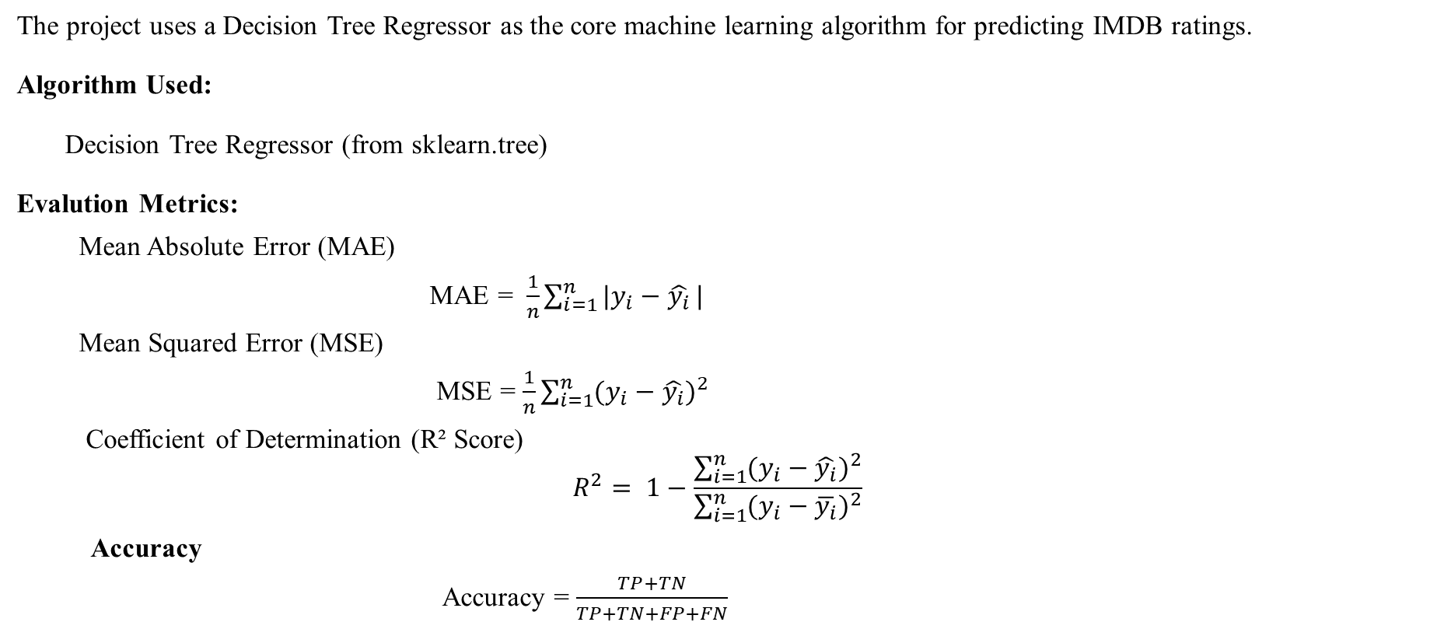
Model
The project uses a Decision Tree Regressor as the core machine learning algorithm for predicting IMDB ratings.
Algorithm Used:
Decision Tree Regressor (from sklearn.tree)
Evalution Metrics:
Mean Absolute Error (MAE)
MAE = $\frac{1}{n}\sum_{i=1}^{n}{|y_{i}−\hat{y_{i}}}|$
Mean Squared Error (MSE)
MSE = $\frac{1}{n}\sum_{i=1}^{n}{{(y_{i}−\hat{y_{i}})}^{2}}$
Coefficient of Determination (R² Score)
$$R^{2}= 1−\frac{\sum_{i=1}^{n}{{(y_{i}−\hat{y_{i}})}^{2}}}{\sum_{i=1}^{n}{{(y_{i}−\overline{y_{i}})}^{2}}}$$
Accuracy
Accuracy = $\frac{TP+TN}{TP+TN+FP+FN}$

Slide 8
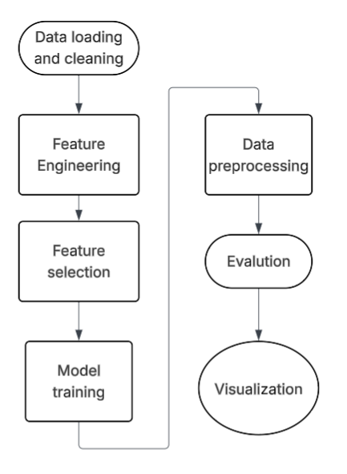
Methodology

Slide 9
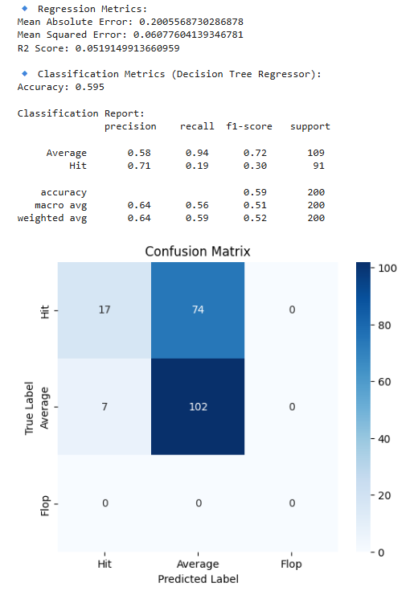
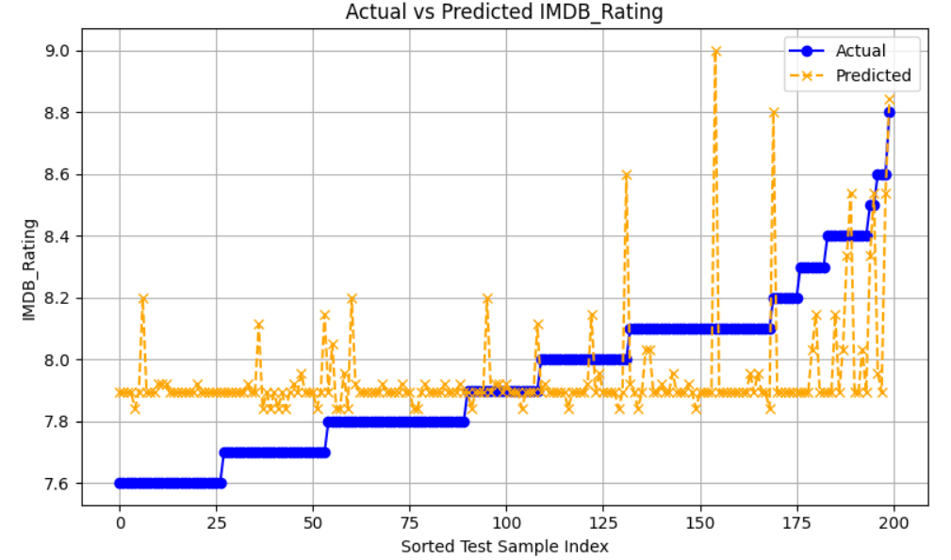
RESULTS

Slide 10
Future scope
The current model can be expanded in several ways:
Feature Expansion: Include additional features like genre, director, cast popularity, runtime, or budget for higher predictive accuracy.
Advanced NLP Techniques: Use BERT, RoBERTa, or VADER sentiment analysis for better textual feature extraction.
Ensemble Models: Apply models like Random Forest, Gradient Boosting, or XGBoost for improved performance.
Real-time Prediction: Integrate the model with a web app (using Flask or Streamlit) to predict ratings of new movies based on user inputs.
OTT Adaptation: Extend this model to predict audience ratings or success probability of OTT platform releases based on trailers, reviews, and metadata.

Slide 11
References
[1] Disentangling the effects on OTT platform performance of three strategies: Pricing, M&As, and content investments
https://www.sciencedirect.com/science/article/pii/S0308596123001118
[2] Impact of ratings of content on OTT platforms and prediction of its success rate
https://link.springer.com/article/10.1007/s11042-023-15887-9
[3] R. K. Sharma and S. Mehta, “Predicting Movie Success: A Machine Learning Approach,” Int. J. Data Sci., vol. 5, no. 2, pp. 112–125, 2022, doi: 10.1016/j.ijdatasci.2022.05.003.
[4] J. Doe, Machine Learning for Predictive Analytics, 2nd ed. Springer, 2021.
[5] M. Kumar, “Sentiment Analysis for Movie Ratings,” in Proc. Int. Conf. AI & Media, 2020, pp. 45–50.
[6] S. Patel, “The Influence of Social Media on Movie Ratings,” J. Digit. Media Stud., vol. 8, no. 3, pp. 67–80, 2023, doi: 10.1109/JDMS.2023.8765432.
[7] P. Johnson and L. Brown, “Analyzing User Ratings and Watch Patterns on OTT Platforms,” J. Media Analytics, vol. 6, no. 1, pp. 25–40, 2023.
[8] A. Smith, “User-Generated Reviews and Their Impact on Streaming Recommendations,” Digit. Media Res. J., vol. 10, no. 4, pp. 55–72, 2021.
[9] R. Williams and M. Clarke, “Predicting Movie Ratings Using Machine Learning: A Comparative Analysis,” in Proc. Int. Conf. AI & Entertainment, 2022, pp. 90–98.
[10] L. Zhang, “Neural Networks for IMDb Rating Predictions: A Deep Learning Approach,” J. Comput. Media Sci., vol. 7, no. 3, pp. 180–200, 2023.
[11] T. Lee and S. Wong, “Sentiment-Based Prediction Models for Movie Ratings,” in Proc. AI & Sentiment Analysis Conf., 2020, pp. 102–112.
[12] D. Kumar, “Understanding IMDb Rating Trends Using Sentiment Analysis,” Int. J. Data Sci. & AI, vol. 9, no. 2, pp. 75–88, 2022.

Slide 12
Thank You

